Slide 1
Circle Revision
EQ – How do I label a circle and find the circumference and area of a circle?
Mrs Stretch
Year 8

Slide 2
24
7
30
Circle Revision
Date
EQ – How do I label a circle and find the circumference and area of a circle?
The circumference of a circle is the boundary of the circle.
The perimeter of a circle
A line drawn from the centre of a circle to the circumference is the radius.
Every radius in a circle is equal in length.

Slide 3
24
7
30
Circle Revision
Date
EQ – How do I label a circle and find the circumference and area of a circle?
A line drawn through the centre from one side of a circle to its opposite side is called the diameter.
It is double the length of the radius.

Slide 4
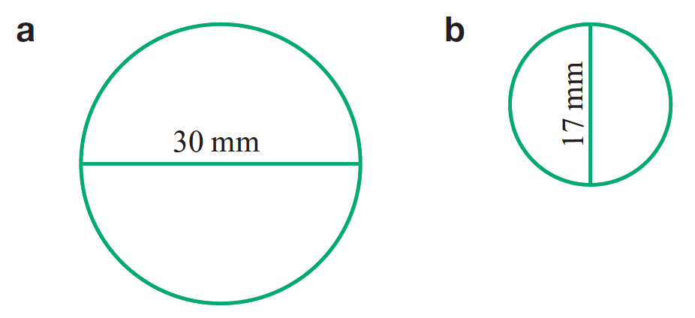
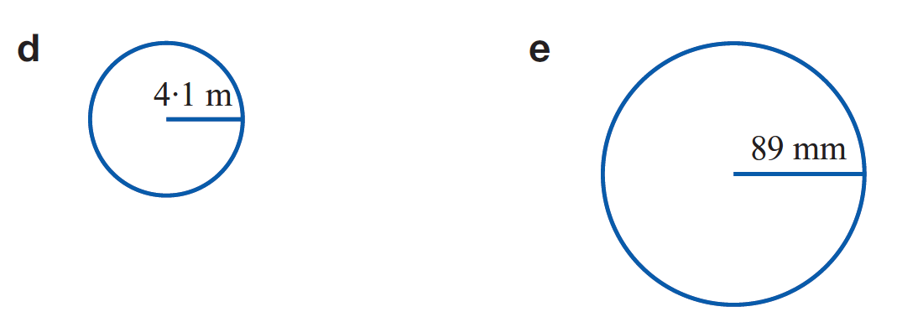


How do I find the circumference of a full circle?
Circumference = π x diameter
Circumference = π x 2 x radius
$$C=πd$$
$$C=2πr$$

Slide 5
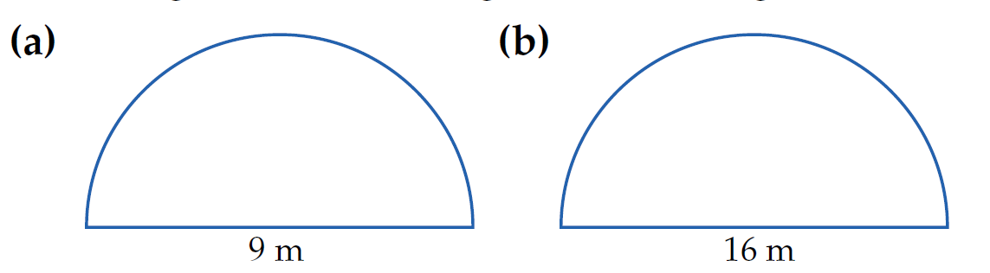


How do I find the circumference of a semi circle?
$C=\frac{1}{2}πd$ + straight line section
$C=\frac{1}{2}2πr$ + straight line section

Slide 6
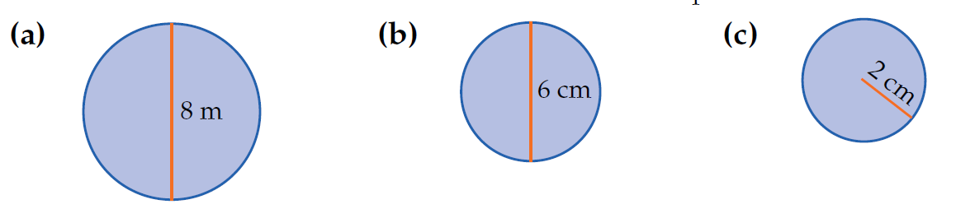

Area of a Full Circle
$$A=πr^{2}$$
If you have a circle with a diameter you will need to half it in order to find the radius.

Slide 7
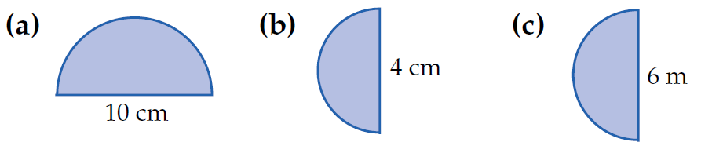

$$A=\frac{1}{2}πr^{2}$$
Area of a Semi Circle

Slide 8
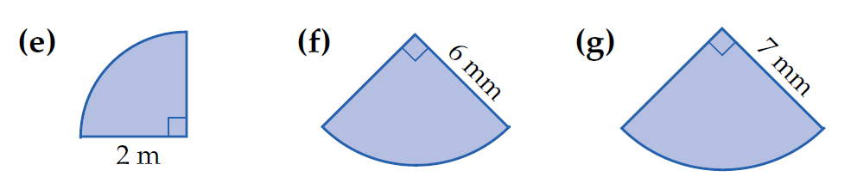

Area of a Quadrant
$$A=\frac{1}{4}πr^{2}$$

